Slide 1


Social media & content creation

Slide 2


Today's agenda
Project recap
Problem
The Analytics team
Process
Insights
Summary

Slide 3

Social Buzz is a fast-growing technology unicorn
That needs to adapt quickly to its global scale.
Social
Project Recap

Slide 4

Problem
Over 1,00,000 Posts per day.
35,500,000 pieces of content per year.
How to bring solution to it?

Slide 5



Marcus Rompton Senior Principle
Me Data Analyst
The Analytics team
Andrew Fleming Chief Technical Architect

Slide 6
Data Analysis
Data Cleaning
Process
1
Pre-processing
2
Sorting
3
4
Categorizing Top 5 Categories
5

Slide 7

Category
studying
healthy eating
technology
food
cooking
dogs
soccer
public speaking
science
tennis
travel
fitness
education
veganism
animals
culture
Insights

Slide 9
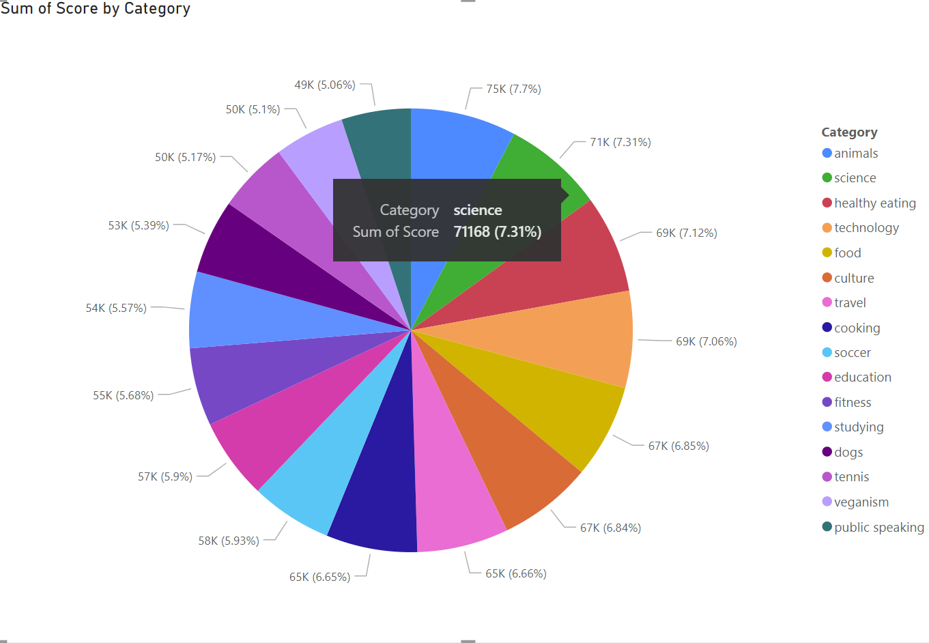

Slide 10

Analysis Conclusion:
Animal and science are the two most popular categories of content people enjoy the most.
Insights:
Food is common among the 5 categories indicated by the user experience base, work on healthy food brands will increase user consumption of food.
Summary

Slide 11
Thank you!
ANY QUESTIONS?

